Slide 1
SEF
Intro to Regulated Development

Slide 2
Lesson Preface
Regulated Development
Most of the content in this lesson comes from a guest speaker that Carlo arranged (years ago when he delivered SEF)
  This guest speaker was from a company named Agfa (that has an office in Waterloo)
    Agfa is a company (from Belgium) whose prime business focus was dealing with film developing equipment … but one day, Agfa saw an opportunity to work in the Healthcare industry dealing with X-Ray film
  Years ago (pre-1999’ish) there was another company in Waterloo called Mitra … they were developing a product for the Healthcare industry that would be able to combine X-Ray film images, with ultrasound images with MRI images with CAT scan images, etc. and also allow Doctor’s, clinicians, radiologists, etc. to annotate (make notes on) the images and store all of these images in an electronic patient record
    This product was to be called IMPAX

Slide 3
Lesson Preface (cont’d)
Regulated Development
Also years ago (May 1995) there was a developer in Waterloo that left NCR (for the second last time) and went to work at Mitra
  This developer was hired as the Software Quality Manager to implement a Revision Control System and also (because of his image processing experience) to design and develop a sub-system within the new product to be the image server
At some point in Mitra’s development of this new project, they needed funding and turned to Agfa to say … “hey – I think that we have this product that you could sell to your customers and make more money with”
  Agfa liked what they saw and invested in Mitra as a silent partner
  Once the product was released, the owner of Mitra saw an opportunity to get out of that business (sell his interests) and retire … he did so and sold his interest to Agfa
  … so the sign changed from Mitra to Agfa

Slide 4
Lesson Preface (cont’d)
Regulated Development
This is a long preface isn’t it ??
Okay – so these slides come from an Agfa guest speaker … who came in to talk about Agfa and IMPAX … but mostly about something known as Regulated Development
In a nut-shell, regulated development is any software engineering work (design, development, etc.) that needs to be governed by a regulating body or organization.
  The governing / regulatory organization does so generally because there is a potential for disaster (loss of human life, money to be lost, etc.)
  If you think about it, any projects that are involved in the healthcare industry, the financial (banking industry), the educational industry would be subject to at least one governing body and would therefore find themselves doing regulated development !
    As an example, I am subject to a governing body for the work I do with my Healthcare application and am also subject to another governing body with the work I do in Wholesale American Lockboxes (banking industry)

Slide 5
Lesson Preface (cont’d)
Regulated Development
This is now officially a really long preface isn’t it ??
Again, still in that nut-shell, when you do your software development in a regulated industry … it generally means
  The processes that you follow need to ensure quality and need to be documented …
  You need to follow a number of additional rules and regulations in your design and development …
  You really need to learn about best practices and be aware of all of the software quality attributes that go around designing and developing the code
  The tools and software that you depend on to do your job must also meet a certain level of quality and expectations …
The bulk of these slides go through what being in a regulated industry means to Agfa, its product and their processes …
  This is a good review of the Testing lesson (and its documentation) from last week

Slide 6
Begin Guest Lecture

Slide 7

Software Development in a Regulated Environment

Slide 8

Overview of AGFA
Agfa is a global organization, headquarters in Mortsel (Belgium) with ~18 thousand employees.
Agfa is active in imaging and supplies hardware, software and digital imaging products and services for many different markets.
Agfa develops, manufactures and distributes analogue and digital products and systems for the making, processing and reproduction of images. Images for healthcare, the printing industry and many other areas including motion pictures.
Business Segment/Groups
Graphic Systems: digital and analogue prepress systems, software, consumables and inkjet.
HealthCare: medical imaging and information management systems.
Specialty Products: consumables (motion picture film, microfilm, film for non-destructive testing) for specific markets.

Slide 9

AGFA HealthCare
Agfa supplies analogue and digital imaging solutions and an innovative range of diagnosis and communication systems, including computed radiography and digital networks for hospitals.
Agfa's equipment, consumables and services are targeted to different hospital departments and comprise comprehensive information systems tailored to the needs of the hospital.

Slide 10
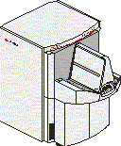











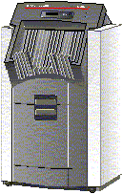


Regulated Development
Modalities
Quality Control Workstations QC3000
R4.5 SP3 Stand-Alone
IMPAX Cluster
R4.5 SP3
MWL
DICOM
HL7
NG3000
DINPACS Broker 1.6a
AS3000
OS3000
Client Stations
Web1000 Server
DICOM Film Laser Printers (Drystar 3000)

Slide 11
FDA Definition of “Medical Device”
Regulated Development
…means an instrument, apparatus, implement, machine, contrivance, implant, in vitro reagent, or other similar or related article, including any component, part, or accessory, which is –
  recognized in the official National Formulary, or the United States Pharmacopeia, or any supplement to them,
  (2) intended for use in the diagnosis of disease or other conditions, or in the cure, mitigation, treatment, or prevention of disease, in man or other animals, or
  (3) intended to affect the structure or any function of the body of man or other animals, and which does not achieve its primary intended purposes through chemical action within or on the body of man or other animals and which is not dependent upon being metabolized for the achievement of its primary intended purposes.

Slide 12
Medical Devices and Types of Software
Regulated Development
Software used as a component, part, or accessory of a medical device
Software that is itself a medical device
Software used in the production of a device (e.g., compilers, programmable logic controllers in manufacturing equipment)
Software used in implementation of the device manufacturer's quality system (e.g., software that records and maintains the device history record)

Slide 13
Regulated Development
The FDA’s analysis of 3140 medical device recalls conducted between 1992 and 1998 reveals that 242 of them (7.7%) are attributable to software failures.
Of those software related recalls, 192 (or 79%) were caused by software defects that were introduced when changes were made to the software after its initial production and distribution.
Why make changes after initial production? Examples:
  Defects (sometimes it’s better to stick with what you know)
  New Features

Slide 14
Regulatory Overview - USA
Regulated Development
Food and Drug Administration (FDA)
Medical device regulations 21 CFR 800-1299
Devices classified by type / function / risk
  Class I - General Controls (Examples devices include elastic bandages, examination gloves, and hand-held surgical instruments )
  Class II - Special Controls (Example devices include powered wheelchairs, infusion pumps, and surgical drapes )
  Class III - Premarket Approval (Examples devices include replacement heart valves, and implanted cerebella stimulators.)
Market clearance based on classification
FDA is a Federal law enforcement agency – very powerful.
FDA puts an emphasis on effectiveness of device.

Slide 15
Regulatory Overview - EU
Regulated Development
Medical Device Directive (MDD) as adopted by EU
Regulation MDD 93/42/EEC plus Annex I – XII
Devices classified by type / function / risk
Devices must be “CE marked” in order to place on market
CE mark route depends on device class and/or manufacturer quality system status.
Class I (lowest risk) can be “self declared” as conforming to requirements.
Class IIa and above, manufacturer must be EN46001 registered and audited by “Notified Body”
Very little direct government involvement, all third party
Focus is on device safety

Slide 16
Regulatory Overview - Canada
Regulated Development
Health Canada’s Therapeutic Products Directorate (TPD), Medical Device Branch (MDB) oversees compliance of Medical Device manufacturers
Medical Device Regulations under the Food and Drug Act of Canada
Canada’s system resembles EU

Slide 17
Regulatory Overview – What is it?
Regulated Development
Medical Device Manufacturers are required by Law to comply with regulations
Medical device manufacturers are held accountable for injuries or deaths attributed to the use of the device, in both Criminal and Civil courts
Development and Manufacturing processes are subject to Regulations (Quality System Regulation, ISO 13485-88, EN46001)
All devices must have the appropriate “market approvals” prior to being placed on the market for sale
Intended use of products must be clearly defined and product must perform as stated

Slide 18
Regulatory Overview…
Regulated Development
Medical devices have to be registered with the FDA.
FDA approval is necessary before you can sell in the USA.
FDA can audit the manufacturer of a medical device without advance notice
  Inspection of quality procedures
  Interviews
  Etc.

Slide 19
Regulatory Overview…
Regulated Development
Various regulatory bodies may have slightly differing focus but goals are the same – safe, effective device designed and manufactured in a controlled, effective manner. Proof of this is through a well documented system.
Regulatory requirements are not an option.
During an audit by any regulatory body, they really don’t care what your intentions are or what you thought you did. There only interest is objective evidence that you a) have a process and b) you have followed that process and can prove it.
We are building medical devices, not padlocks.

Slide 20
Enforcement (FDA)
Regulated Development
FDA 483 – The first sign of trouble. This is the form used by investigators to record their observations of non-compliance
Warning letter. Addressed to the CEO.
Stop distribution after having a legal injunction issued by a judge. Seize the facility – lock the doors. Seize the product.
Require a recall.
Stop product approvals.
Impose civil penalties against the company or individual.
Debarment (kicked out of the industry).
Imprisonment.

Slide 21
HEALTH INSURANCE PORTABILITY AND
ACCOUNTABILITY ACT (HIPAA)
Regulated Development
Other regulations such as HIPAA define constraints on your software in order to ensure patient information is protected
  Auditing
  Controls on who can view patient information
  Security
Satisfying of HIPAA requirements is through a combination of software and policies (rules that govern behaviour).

Slide 22
Software is Different from Hardware
Regulated Development
While software shares many of the same engineering tasks as hardware, it is different.
The quality of a hardware product is highly dependent on design, development and manufacture
the quality of a software product is highly dependent on design and development with a minimum concern for software manufacture.
For software, the hardest part is not manufacturing thousands of programs that work alike; it is getting just one program that works to design specifications. The vast majority of software problems are traceable to errors made during the design and development process.
Unlike hardware, software components are rarely standardized. While object oriented development holds promise for reuse of software, it requires a significant up front investment of resources to define and develop reusable software code.

Slide 23
Regulated Development
Another related characteristic of software is the speed and ease with which it can be changed.
  This can lead both software and non-software professionals to the false impression that software problems can be easily corrected.
  Combined with a lack of understanding of software, it can lead engineering managers to believe that tightly controlled engineering is not as much needed for software as for hardware.
  In fact, the opposite is true. Because of its complexity, the development process for software should be even more tightly controlled than for hardware, in order to prevent problems which cannot be easily detected later in the development process.
Repairs made to correct software defects, in fact, establish a new design. Seemingly insignificant changes in software code can create unexpected and very significant problems elsewhere in the software program.

Slide 24
Regulatory Philosophy
Regulated Development
If you don’t have a record to prove it; it didn’t happen.
Quality cannot be inspected or tested into a product.
It must be designed in.
Management has the most impact through the leadership they exercise and the systems they implement.

Slide 25
Off-The-Shelf Software
Regulated Development
Where the software is developed by someone other than the device manufacturer (e.g., off-the-shelf software) the software developer may not be directly responsible for compliance with FDA regulations.
The party with regulatory responsibility (i.e., the device manufacturer) needs to assess the adequacy of the off-the-shelf software developer’s activities and determine what additional efforts are needed to establish that the software is validated for the device manufacturer’s intended use.

Slide 26
Software Used in Production
Regulated Development
Any software used to automate any part of the device production process or any part of the quality system must be validated for its intended use.
This requirement applies to any software used to automate device design, testing, component acceptance, manufacturing, labeling, packaging, distribution, complaint handling, or to automate any other aspect of the quality system.
In addition, computer systems used to create, modify, and maintain electronic records and to manage electronic signatures are also subject to the validation requirements.
All production and/or quality system software, even if purchased off-the-shelf, should have documented requirements that fully define its intended use, and information against which testing results and other evidence can be compared, to show that the software is validated for its intended use.

Slide 27
Producing Quality Software
Regulated Development
In order to produce quality software, you must have a process in place and consistently follow that process
This is indicated in the content of the following slides
  Following a Project Methodology
  Developing a Project Schedule
  Gathering and documenting your Requirements
  Identifying risks within your project
  Creating a Requirements Traceability Matrix
  Creating and documenting a Test Plan
  Many, many more …

Slide 28
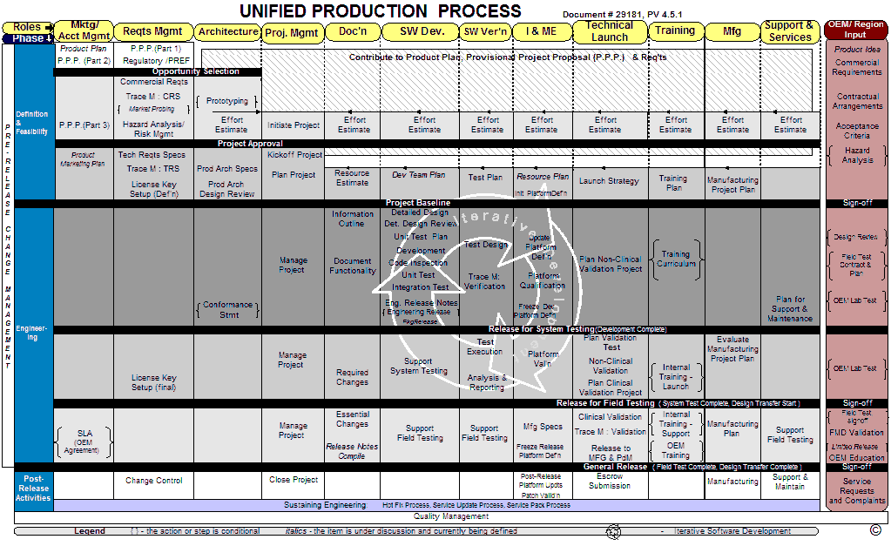

Slide 29
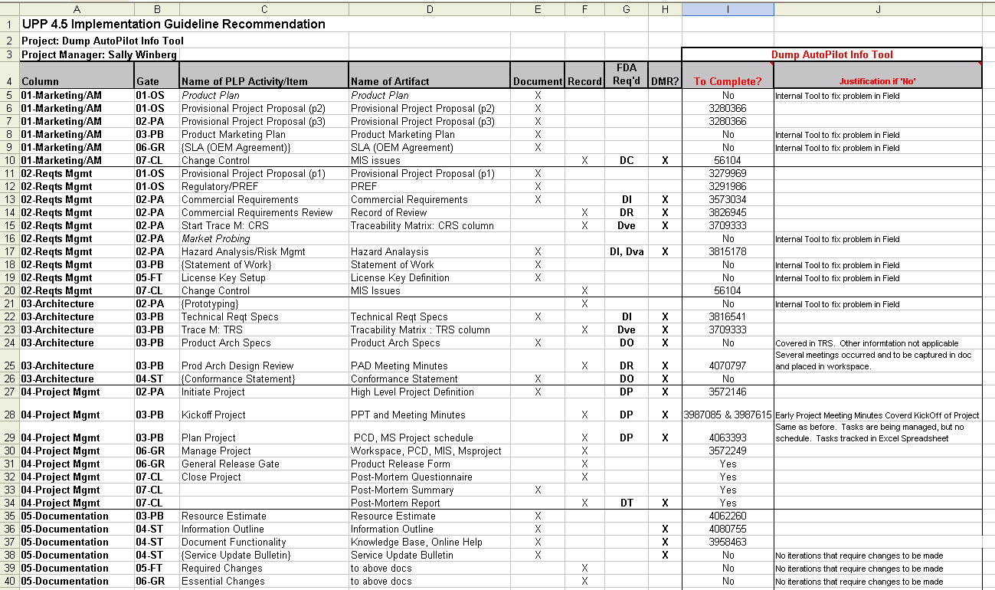
Process Implementation Guidelines
Regulated Development

Slide 30
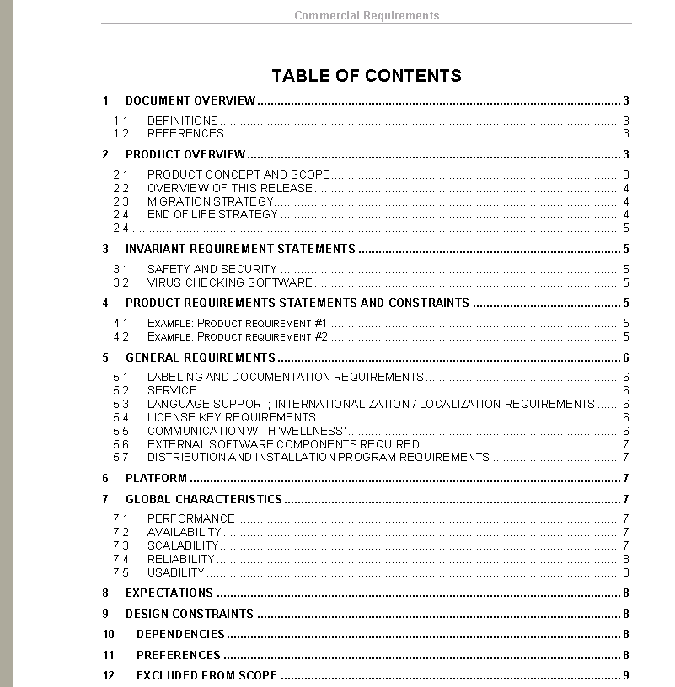
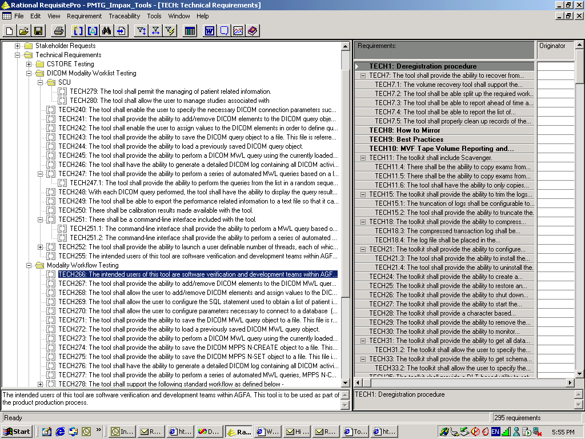
Requirements
Regulated Development

Slide 31
Regulated Development
Qualities of Effective Requirements
Written
  They have been documented and can be referred to by anyone associated with the project, at any time (including prior to development start). Pictures are great!
Informed
  They are a reflection of the customer’s needs.
Testable
  A requirement that cannot be validated isn’t a requirement.
Prioritized
  Needed to support iterative development, set milestones
  Keep iterations as small as possible, maximum of six months
  When push comes to shove, some things have to go
Complete
  Manage risk, avoid surprises – complete at some level of abstraction
Explained
  Provide background information
  Vital for development to make choices on implementation and understand the problem domain
Understood

Slide 32
Requirements to Communicate What is Wanted
Regulated Development
The user requirements define what is wanted in non-technical terms
  User requirements define the results to be provided to the user and this can be done without functional or behavioural definition of the system
  the user never needs a database: that's a solution
The system requirements shows what the system must do, and any constraints on that functionality
Many projects fail even though the software is technically high quality
  Quality is a measure of how closely the solution satisfies the requirements

Slide 33
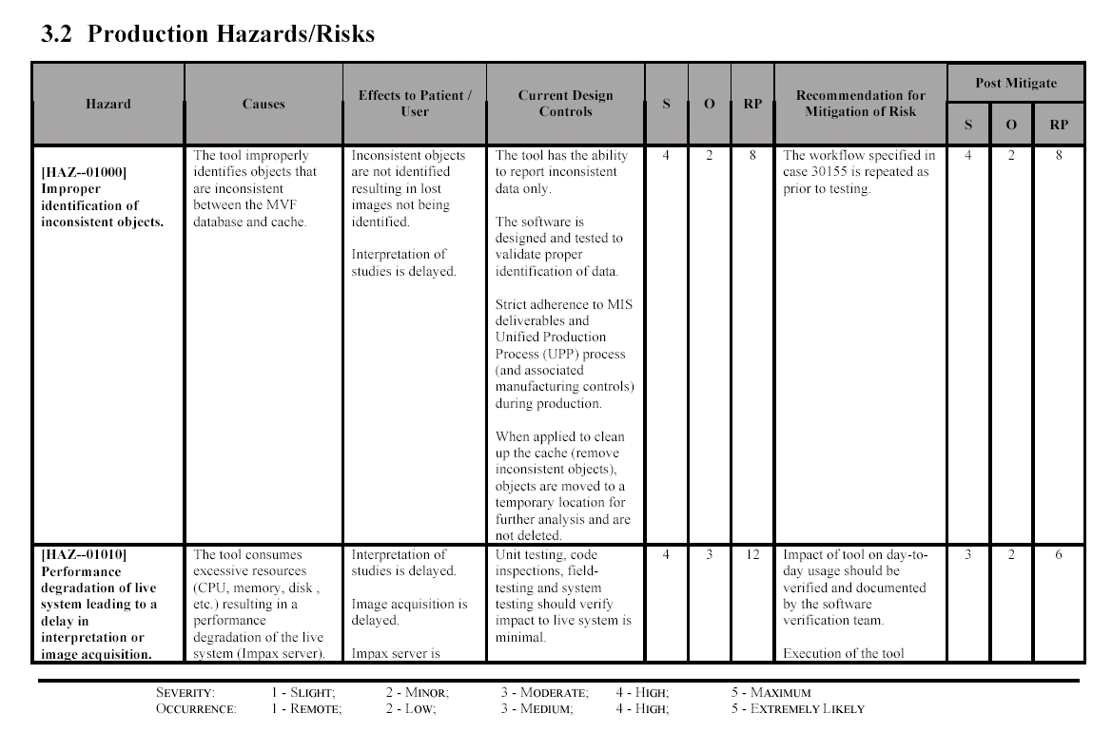
Hazards / Risk Analysis
Regulated Development

Slide 34
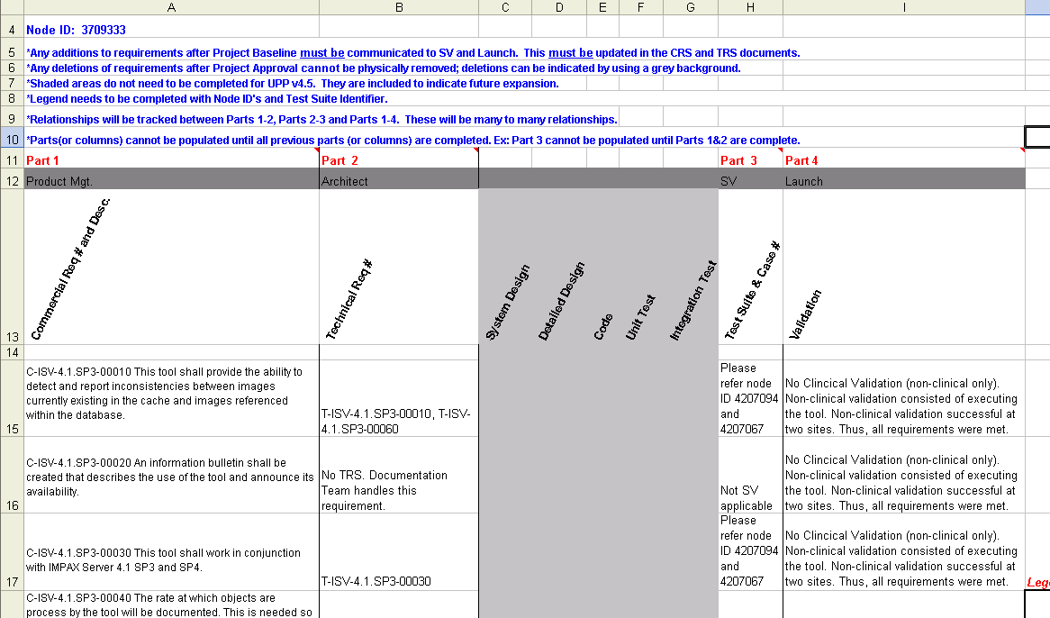
Traceability Matrix
Regulated Development

Slide 35
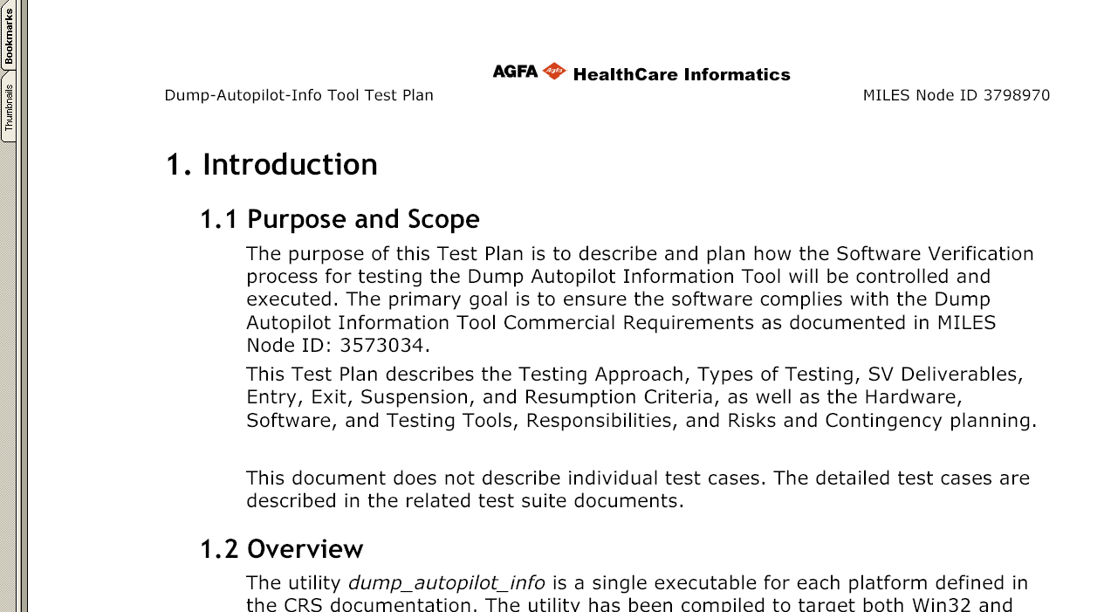
Test Plan
Regulated Development

Slide 36
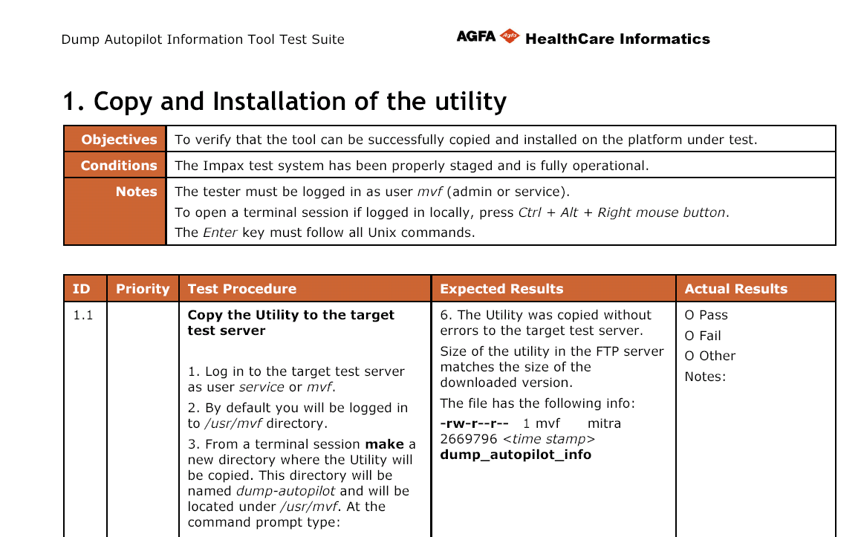
Test Suite
Regulated Development

Slide 37
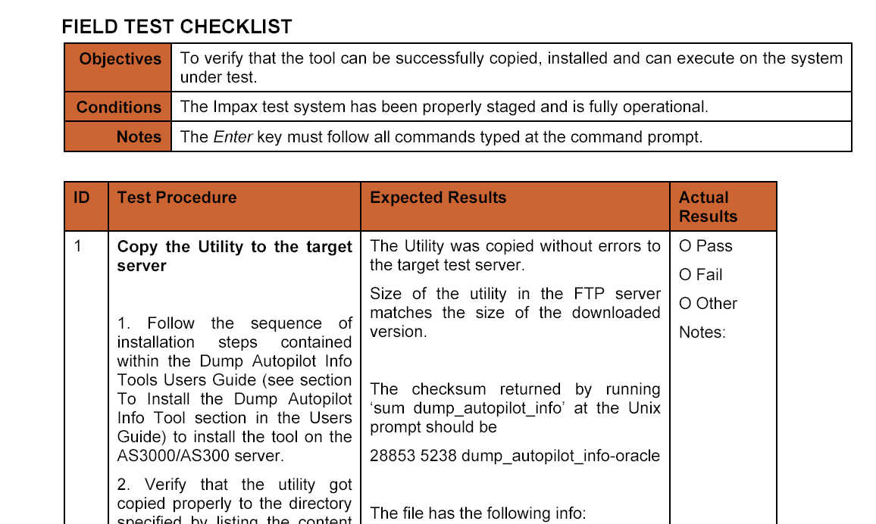
Field Testing
Regulated Development

Slide 38
Verification verses Validation
Regulated Development
It is important as a Software Engineering Student that you learn the distinction and difference between verification and validation.
  VERIFICATION is proof that requirements were met.
  VALIDATION is proof that it will work as intended .

Slide 39
PRINCIPLES OF SOFTWARE VALIDATION
Regulated Development
REQUIREMENTS
  provides a baseline for both validation and verification
DEFECT PREVENTION
  focus on preventing the introduction of defects into the software development process
TIME AND EFFORT
  software is validated requires time and effort. Preparation for software validation should begin early
SOFTWARE LIFE CYCLE
  The software life cycle contains software engineering tasks and documentation necessary to support the software validation effort
PLANS
  The software validation plan defines "what" is to be accomplished through the software validation effort

Slide 40
PRINCIPLES OF SOFTWARE VALIDATION
Regulated Development
PROCEDURES
  These procedures establish "how" to conduct the software validation effort
SOFTWARE VALIDATION AFTER A CHANGE
  a seemingly small local change may have a significant global system impact
VALIDATION COVERAGE
  Validation coverage should be based on the software’s complexity and safety risk – not on firm size or resource constraints.
INDEPENDENCE OF REVIEW
  When possible, an independent evaluation is always better, especially for higher risk applications.
FLEXIBILITY AND RESPONSIBILITY
  The device manufacturer has flexibility in choosing how to apply these validation principles, but retains ultimate responsibility for demonstrating that the software has been validated

Slide 41
The Standish Group CHAOS Report
Regulated Development
As we’ve been told, the cost of fixing defects is quite expensive …
Latest Standish Group CHAOS Report Shows Project Success Rates Have Improved by 50% since 1994.
Project success rates have increased to just over a third or 34% of all projects. This is a 100% plus improvement over the 16% rate in 1994. Project failures have declined to 15% of all projects, which is more than half the 31% in 1994. Challenged projects account for the remaining 51%.

Slide 42
Opportunities
Regulated Development
You have a great opportunity
By understanding the impact of software on people’s lives, you can begin to appreciate the importance of design standards.
Software is first and foremost about people

Slide 43
End Guest Lecture

Slide 44
What you should Know

Slide 45
So much information !!
Regulated Development
There was so much information conveyed in this lecture that it may be hard for you to pick out the important parts … the parts that you should really understand and remember …
So I’ll help by summarizing them for you …

Slide 46

Recap : Regulated Development
Regulated Development
Regulated Development is :
  Any software engineering work (design, development, etc.) that needs to be governed by a regulating body or organization
  Depending on the software project and its impact in the industry, any software developed for the healthcare, financial or educational industries would find themselves doing regulated development
When you do your software development in a regulated industry … it generally means :
  The processes that you follow need to ensure quality and need to be documented …
    A good rule of thumb to remember is this … If it is not documented, then it didn’t happen
  You need to follow a number of additional rules and regulations in your design and development …
  You really need to learn about best practices and be aware of all of the software quality attributes that go around designing and developing the code
  You need to adopt and follow a disciplined QA methodology
    You’ll learn more on these in other courses

Slide 47

Recap : Regulated Development
Regulated Development
If you develop a system or software solution governed by a regulating body or organization :
  You need to research and understand the regulations and criteria in each country or region that you plan to release it in around the world
  It is quite possible that different countries have different criteria – and your software must satisfy all of them
Depending on the country’s regulations :
  Not only does your final and complete solution / system / product need to comply with any regulations, but …
    Quite often any sub-part or sub-system of the overall solution also needs to comply…
    As well, any tool or process used in the creation of the solution may be subject to the regulations as well…

Slide 48

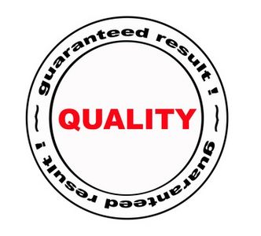
Recap : Regulated Development
Regulated Development
Again each country is different, but – failure to comply with regulations
  Escalates from Warning Letters to your CEO to $$ Fines to being kicked out of the industry to imprisonment …
The general Regulated Development Philosophy is :
  If you don’t have a record to prove it – it didn’t happen
  Quality cannot be inspected or tested into a product – it must be designed in
  Success in a regulated industry requires decision makers to be informed, make sound judgments and lead by example

Slide 49
Recap : Verification & Validation
Regulated Development
The terms verification and validation are often used interchangeably – but this is incorrect …
Verification is :
  Proof that requirements were met
    Software verification involves the execution of tests designed to cover each of the specific system requirements
  Asking yourself … “Was the product built right ?”
Validation is :
  Proof that the system will work as intended
    Software validation involves the execution of tests designed to ensure that the system conforms to the user’s needs and intended use
  Asking yourself … “Was the right product built ?”

Slide 50
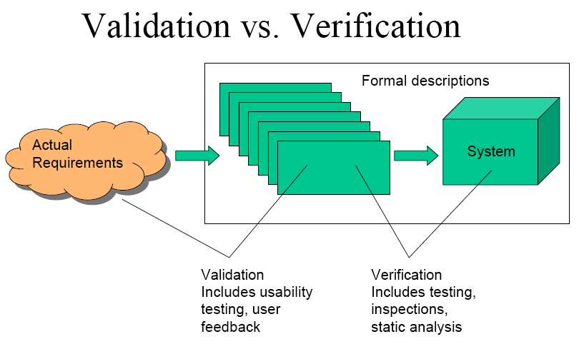
Recap : Verification & Validation
Regulated Development
Verification takes place before validation, and not vice versa
  Verification evaluates documents, plans, code, requirements, and specifications
  Validation, on the other hand, evaluates the product itself

Slide 51
Recap : Verification & Validation
Regulated Development
It is easy to tie the terms verification and validation (V&V factors) back to our lesson on Testing
  Recall we discussed the various Levels of Testing – Do you remember them ?
    If you said : Unit Testing, Integration Testing, System Testing, User Acceptance Testing and Regression Testing – then you’re right !
  The table below indicates the level of testing, the V&V factor and a number indicating how much effort is typically put into testing that V factor at that testing level
    The scale used is a number from 0 to 5
Level of Testing | Verification | Validation
Unit | 5 | ~0
Integration | 3 | 1-2
System | 2 | 5
UAT | 0 | 5 (UAT’s only purpose)
Regression | -- Must do both equally --

